Slide 1

Spring MVC
[PHONG HA]

Slide 2
Content
HTTP Servlet
What is Spring MVC
Request Processing Workflow
Web Application Context
Important Annotations

Slide 3
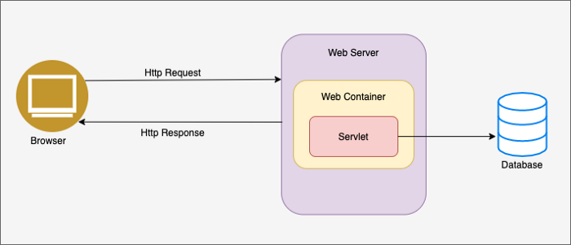
1. HTTP Servlet
Java Servlets are software component that runs on a web server or an application server and be responsible to receive the request from the web server, process the request, and respond back to the server
Notes:
Deployed inside Servlet container
Act as a middle layer between Web browser and DB or applications on Web server

Slide 4
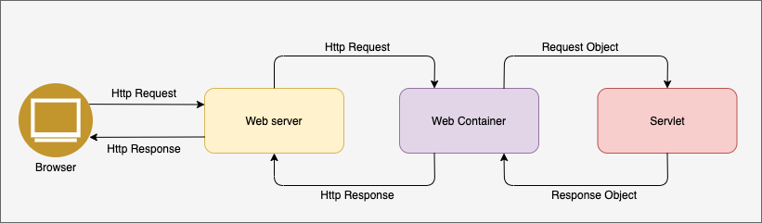
Web container
Also known as servlet container or servlet engine.
Web container initiates the Servlet that matches the request URL by invoking the service() method of Servlet class.
Notes:
Deployed inside Servlet container
Act as a middle layer between Web browser and DB or applications on Web server

Slide 5
Lifecycle
Servlet life cycle consists methods that covers entire process from its creation till the destruction. Following are the lifecycle steps:
init() is called only once. The servlet is normally created when a user first invokes a URL corresponding to the servlet, but you can also specify that the servlet be loaded when the server is first started.
service() is the main method to perform the actual tak. The web container (servlet container) calls the service() method to handle requests coming from the client. Each time the server receives a request for a servlet, the web container spawns a new thread and calls service(). This method checks the HTTP request type (GET, POST, PUT, DELETE, etc.) and calls doGet, doPost, doPut, doDelete, etc. methods as appropriate.
destroy() method is called only once at the end of the life cycle of a servlet. This method gives your servlet a chance to close database connections, halt background threads, write cookie lists or hit counts to disk, and perform other such cleanup activities. After the destroy() method is called, the servlet object is marked for garbage collection.

Slide 6
2. What is Spring MVC
Spring Web MVC is the original web framework built on the Servlet API.
The Spring Web MVC framework provides Model-View-Controller (MVC) architecture and ready components that can be used to develop flexible and loosely coupled web applications.
The Model encapsulates the application data and in general they will consist of POJO.
The View is responsible for rendering the model data and in general it generates HTML output that the client's browser can interpret.
The Controller is responsible for processing user requests and building an appropriate model and passes it to the view for rendering.
Request-driven, designed around a central servlet that dispatches requests to controllers and offers other functionality that facilitates the development of web applications
Notes:
Deployed inside Servlet container
Act as a middle layer between Web browser and DB or applications on Web server

Slide 7
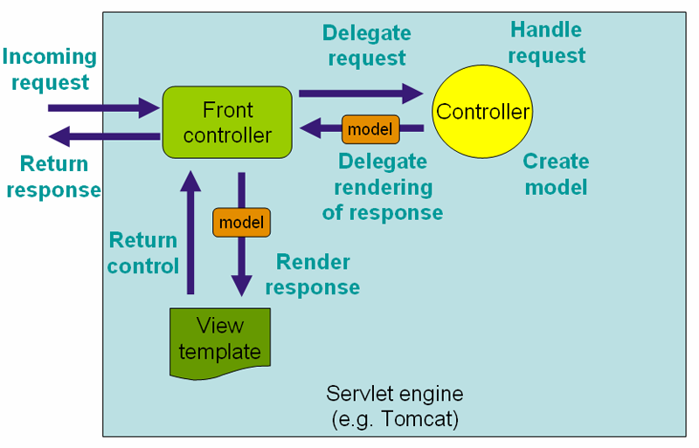
3. Request Processing Workflow

Slide 8
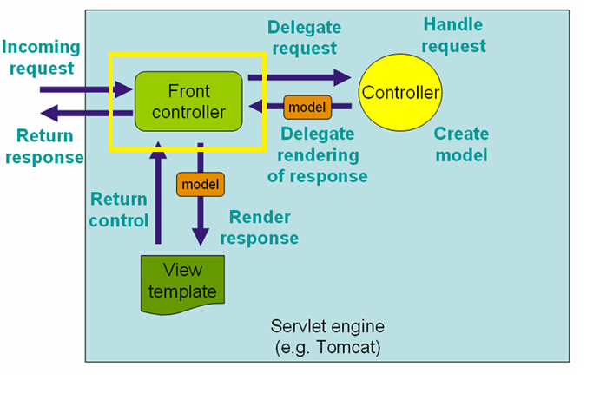
DispatcherServlet
DispatcherServlet acts as a central entry point to the Spring MVC application.
Every request is handled by DispatcherServlet.
DispatcherServlet is an expression of the Front Controller pattern.

Slide 9
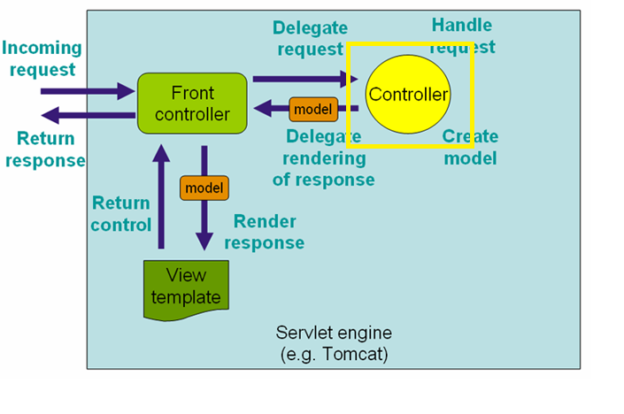
Controllers
After receiving an HTTP request, DispatcherServlet consults the HandlerMapping to call the appropriate Controller.
The Controller takes the request and calls the appropriate service methods based on used GET or POST method. The service method will set model data based on defined business logic and returns view name to the DispatcherServlet.
When the controller has finished processing, the DispatcherServlet determines which view to render.

Slide 10
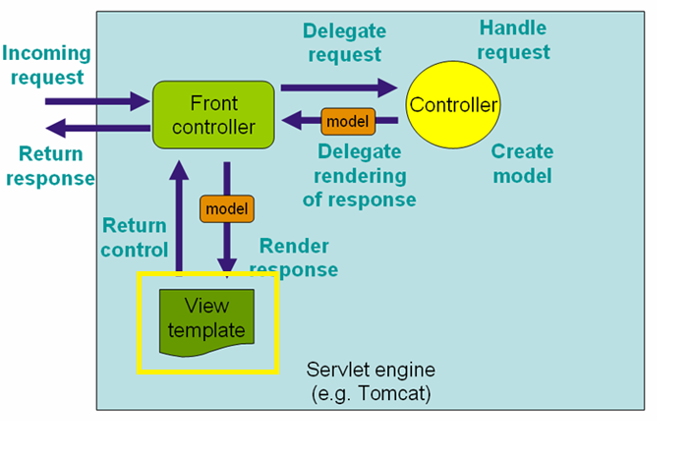
View
The DispatcherServlet will take help from ViewResolver to pickup the defined view for the request.
Once view is finalized, The DispatcherServlet passes the model data to the view which is finally rendered on the browser.

Slide 11
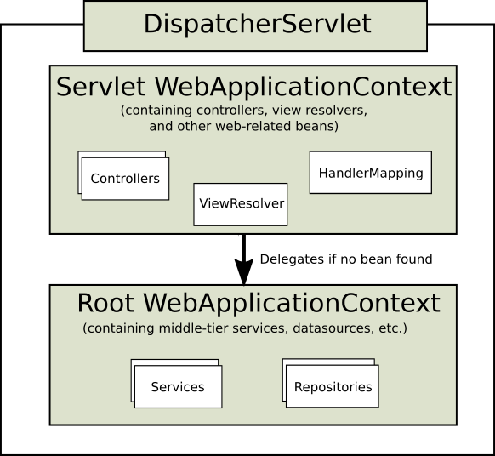
4. Web Application Context
DispatcherServlet expects a WebApplicationContext (an extension of a plain ApplicationContext) for its own configuration.
WebApplicationContext has a link to the ServletContext and the Servlet with which it is associated.
The root WebApplicationContext typically contains infrastructure beans, such as data repositories and business services that need to be shared across multiple Servlet instances. Those beans are effectively inherited and can be overridden (that is, re-declared) in the Servlet-specific child WebApplicationContext, which typically contains beans local to the given Servlet.

Slide 12
5. Important Annotations
@Controller and @RestController
@Requestmapping
@GetMapping, @PostMapping, @PutMapping and @DeleteMapping
@RequestParam, @PathVariable
@RequestBody
@ResponseBody

Slide 13

Thank You!

